Slide 1
Parametric and Nonparametric Tests
Hypothesis test → which test should I use?

Slide 2
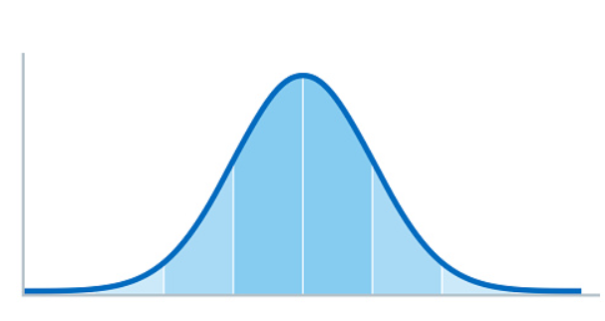
Parametric and Nonparametric Tests
If your data is NOT normally distributed → nonparametric Tests
If your data is normally distributed → parametric Tests

Slide 3
Parametric and Nonparametric Tests
In general, there are less assumptions for non-parametric tests than for parametric tests.
WHY do we need parametric tests?
Parametric tests are generally more POWERFUL than non-parametric test.
In parametric test, a small different in data or a smaller sample size is usually sufficient to REJECT the NULL hypothesis
→ If possible, always use parametric tests

Slide 4
Parametric and Nonparametric Tests
 | Parametric Tests | Nonparametric Test
One Sample | Simple t-Test | Wilcoxon test for one sample
Two Dependent samples (related samples) | Paired Sample t-Test | Wilcoxon Signed-rank Test
Two independent samples (unrelated samples) | Unpaired Sample t-Test | Wilcoxon Rank-sum Test (Mann-Whitney U Test)
More than two independent samples | One factorial ANOVA | Kruskal-Wallis Test
More than two dependent samples | Repeated Measures ANOVA | Friedman Test
Correlation between two variables | Pearon-Korrelation | Spearman-Koreelation

Slide 5
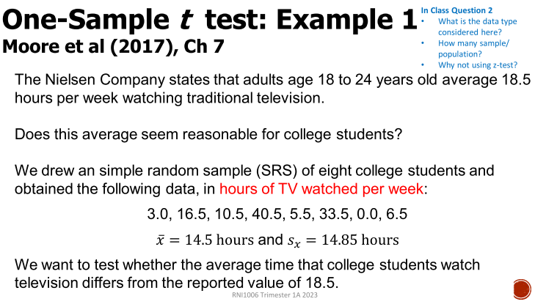
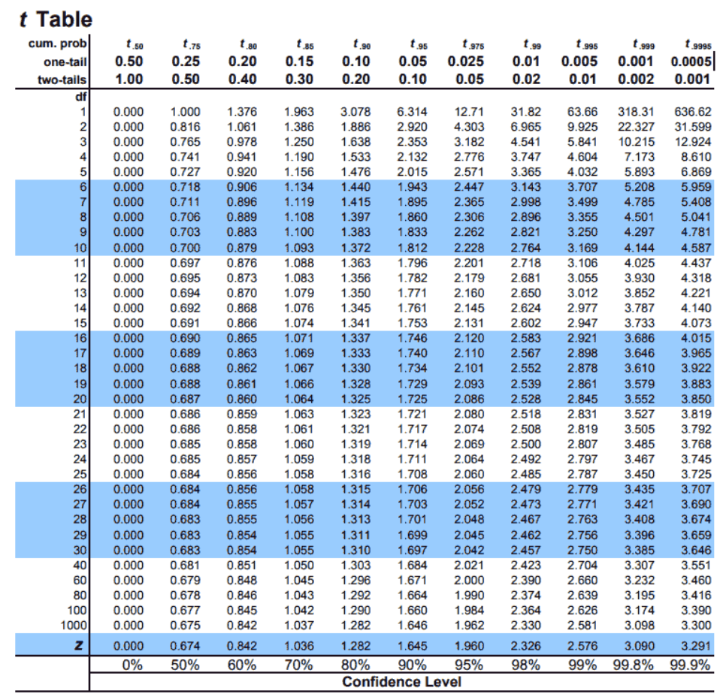
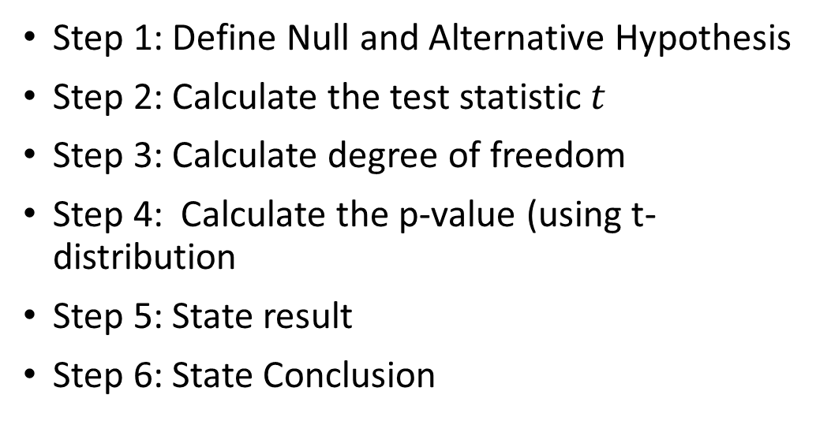
One sample T-Test Example
Step 1: Define Null and Alternative Hypothesis
Step 2: Calculate the test statistic $t$
Step 3: Calculate degree of freedom
Step 4: Calculate the p-value (using t-distribution
Step 5: State result
Step 6: State Conclusion

Slide 6
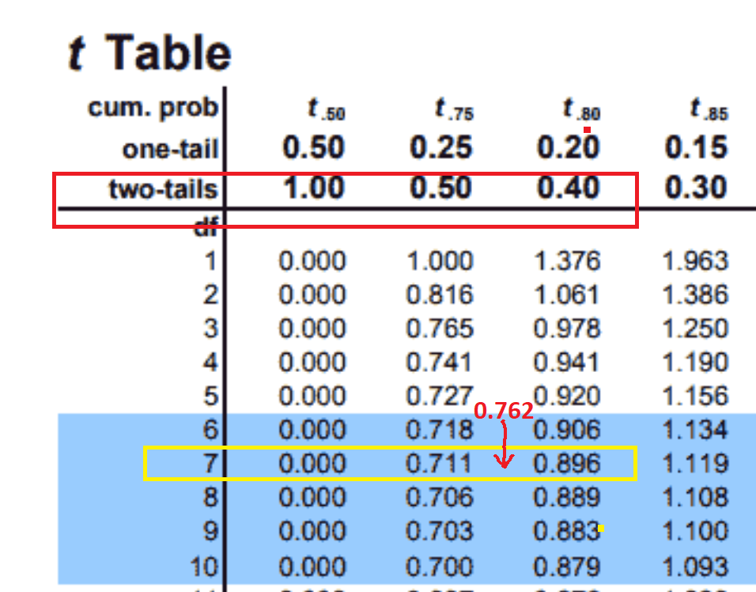
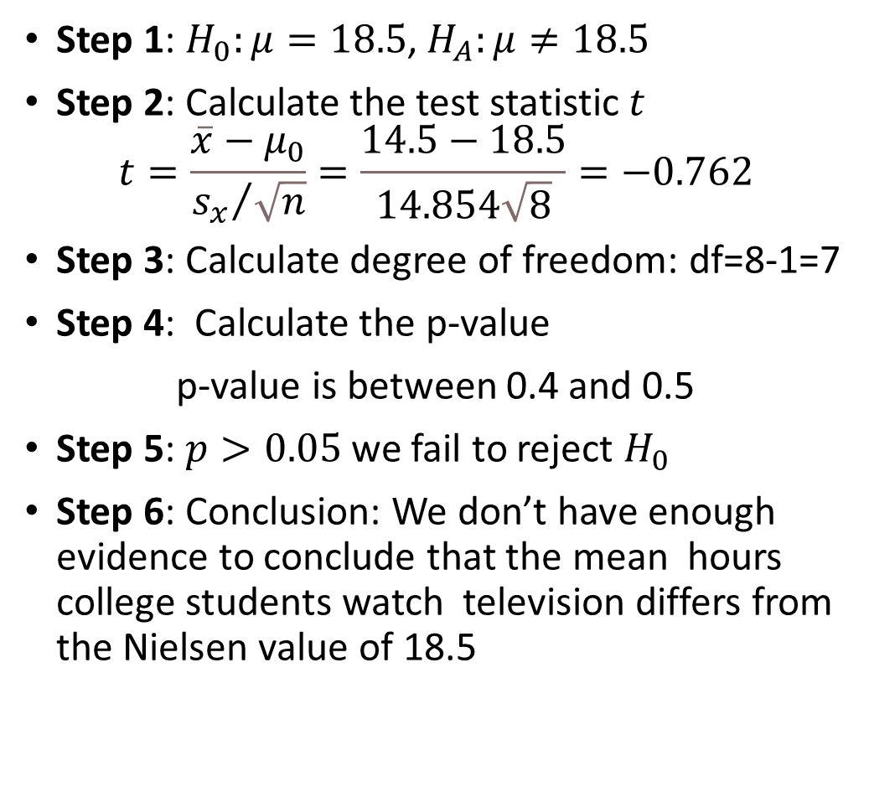
One sample T-Test Example
Hours
3
16.5
10.5
40.5
5.5
33.5
0
6.5
Step 1: $H_{0}:μ=18.5$, $H_{A}:μ≠18.5$
Step 2: Calculate the test statistic $t$
$$t=\frac{\overline{x}−μ_{0}}{{s_{x}}/{\sqrt{n}}}=\frac{14.5−18.5}{14.854\sqrt{8}}=−0.762$$
Step 3: Calculate degree of freedom: df=8-1=7
Step 4: Calculate the p-value
p-value is between 0.4 and 0.5
Step 5: $p>0.05$ we fail to reject $H_{0}$
Step 6: Conclusion: We don’t have enough evidence to conclude that the mean hours college students watch television differs from the Nielsen value of 18.5
mean= | 14.5
Std.dev= | 14.85405

Slide 7
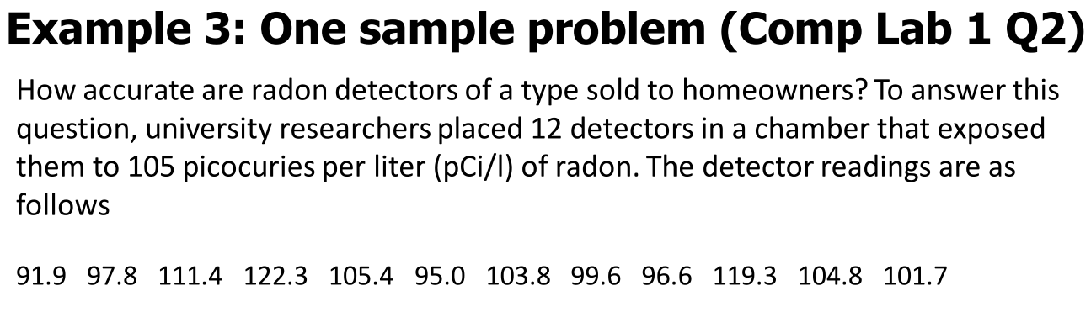
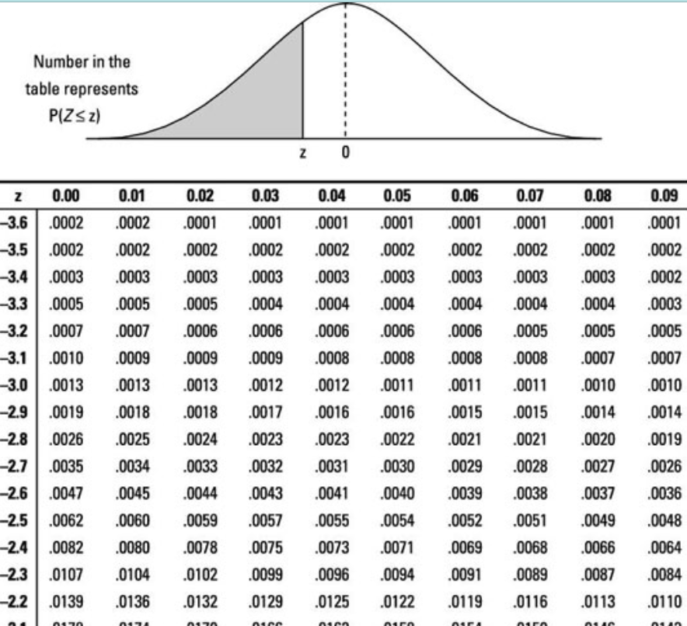
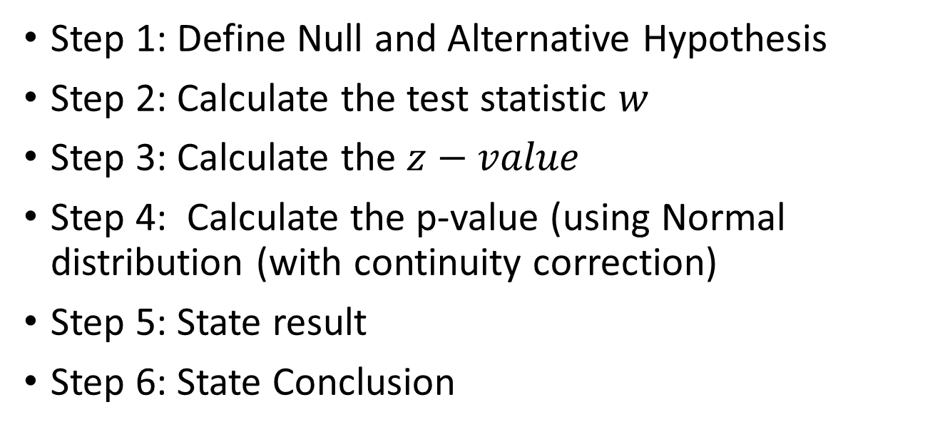
Wilcoxon Signed-Rank Test Example
Step 1: Define Null and Alternative Hypothesis
Step 2: Calculate the test statistic $w$
Step 3: Calculate the $z−value$
Step 4: Calculate the p-value (using Normal distribution (with continuity correction)
Step 5: State result
Step 6: State Conclusion

Slide 8
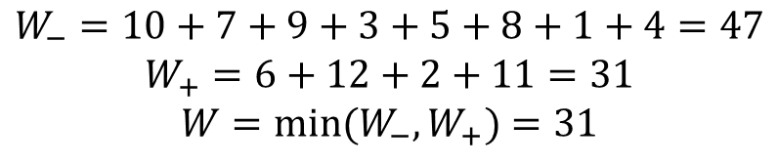
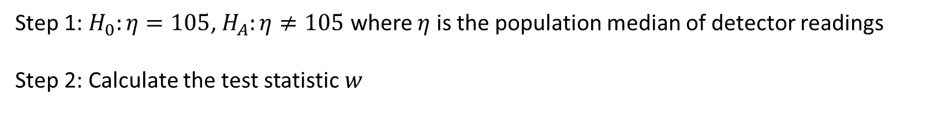
Wilcoxon Signed-Rank Test Example
Step 1: $H_{0}:η=105$, $H_{A}:η≠105$ where $η$ is the population median of detector readings
Step 2: Calculate the test statistic $w$
readings | median | xi-median
91.9 | 105 | -13.1
97.8 |  | -7.2
111.4 |  | 6.4
122.3 |  | 17.3
105.4 |  | 0.4
95 |  | -10
103.8 |  | -1.2
99.6 |  | -5.4
96.6 |  | -8.4
119.3 |  | 14.3
104.8 |  | -0.2
101.7 |  | -3.3
rank
10
7
6
12
2
9
3
5
8
11
1
4
Abs | Sorted | Rank
13.1 | 0.2 | 1
7.2 | 0.4 | 2
6.4 | 1.2 | 3
17.3 | 3.3 | 4
0.4 | 5.4 | 5
10 | 6.4 | 6
1.2 | 7.2 | 7
5.4 | 8.4 | 8
8.4 | 10 | 9
14.3 | 13.1 | 10
0.2 | 14.3 | 11
3.3 | 17.3 | 12
$$W_{−}=10+7+9+3+5+8+1+4=47$$
$$W_{+}=6+12+2+11=31$$
$${W=min⁡(W}_{−},W_{+})=31$$

Slide 9
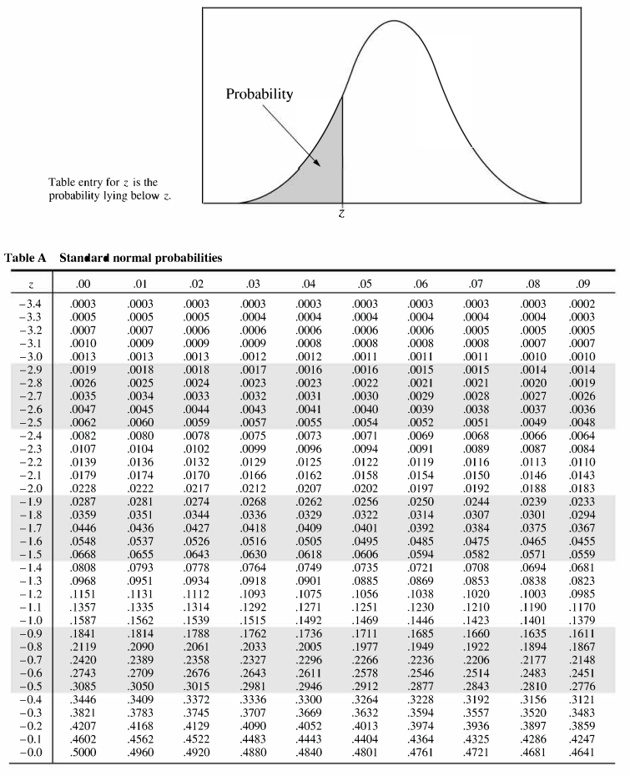
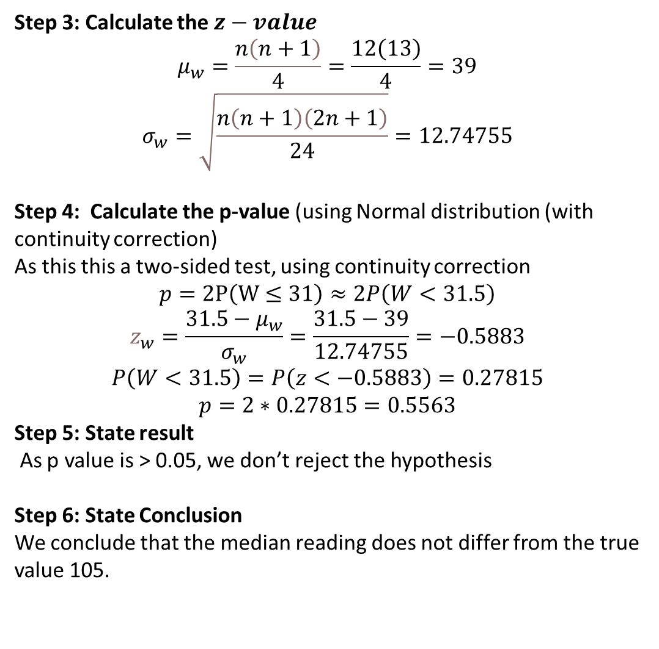
Wilcoxon Signed-Rank Test Example
Step 3: Calculate the $z−value$
$$μ_{w}=\frac{n\left(n+1\right)}{4}=\frac{12\left(13\right)}{4}=39$$
$$σ_{w}=\sqrt{\frac{n\left(n+1\right)\left(2n+1\right)}{24}}=12.74755$$
Step 4: Calculate the p-value (using Normal distribution (with continuity correction)
As this this a two-sided test, using continuity correction
$$p=2P\left(W≤31\right)≈2P\left(W<31.5\right)$$
$$z_{w}=\frac{31.5−μ_{w}}{σ_{w}}=\frac{31.5−39}{12.74755}=−0.5883$$
$$P\left(W<31.5\right)=P\left(z<−0.5883\right)=0.27815$$
$$p=2∗0.27815=0.5563$$
Step 5: State result
As p value is > 0.05, we don’t reject the hypothesis
Step 6: State Conclusion
We conclude that the median reading does not differ from the true value 105.

